Slide 1
Iteration - For

Slide 2
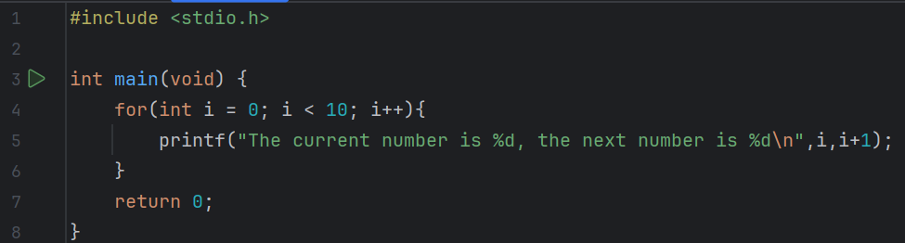
Predict
What do you think this code does?
It sets the initial value of I as 0 and adds 1 to it every time the loop iterates until it reaches ten. Therefore, ten times it outputs what the current value of I is and what the next one is, which is I add 1. This is done by using a count controlled for loop.

Slide 3
Run
Download the code from Github and run it!
What does the code do?
It sets the initial value of I as 0 and adds 1 to it every time the loop iterates until it reaches ten. Therefore, ten times it outputs what the current value of I is and what the next one is, which is I add 1
Does this match your prediction?
Yes

Slide 4
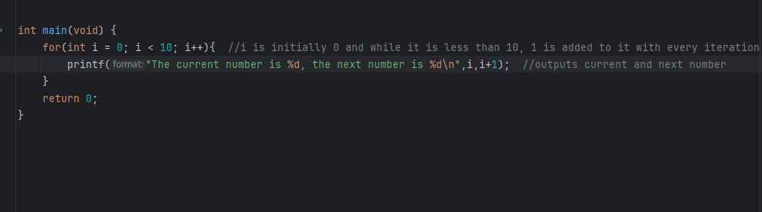
Investigate
Investigation Activities
What does i++ do? What is the opposite? Adds one to I, increments it, the opposite is i-- Annotate lines 4 & 5 to explain what each line of code does.

Slide 5
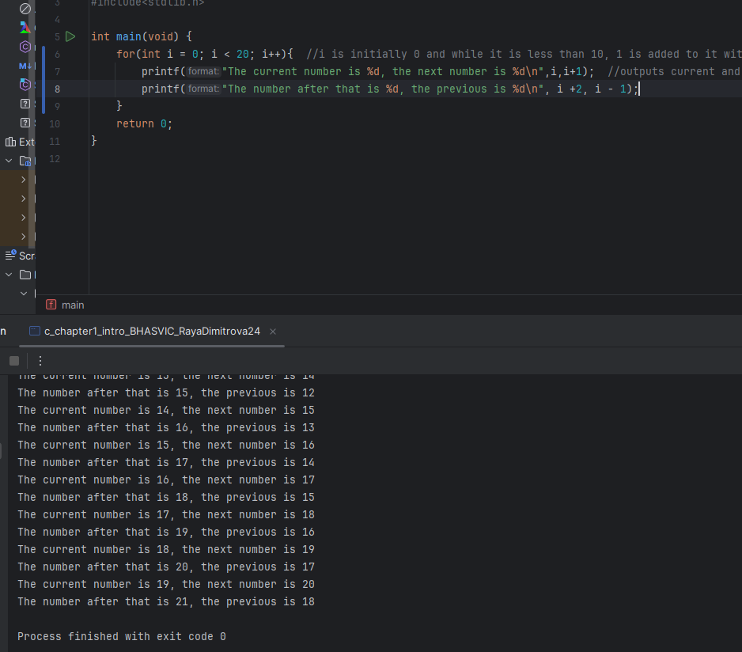
Modify
Modification Activities
Modify the program to loop 20 times. Modify the program to display the current number, the next two numbers and the previous number.

Slide 6
Make
Make Activities
Write a program that uses a FOR loop to display the nine times table to the screen. Requirements: PART ONE The number in purple should use the loop counter, and count up to 12 times Each multiplication should be on a separate line e.g. 1 x 9 = 9 2 x 9 = 18…. The program should be efficient and only require one printf in your loop to create and change the output each time to display the lines

Slide 7
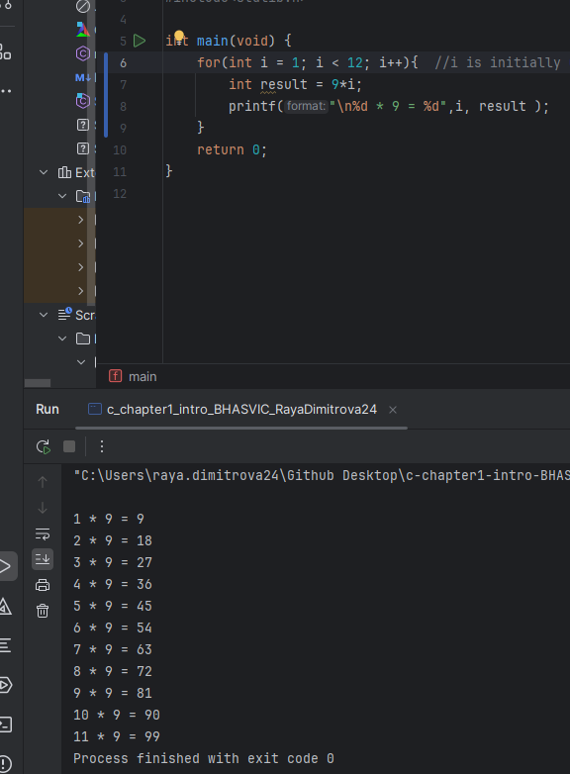

Slide 8
Make
Make Activities
PART TWO Adapt your program so that it asks the user which times table they would like to use (rather than using *9). The program should then display that times table from 1 times up to 12 times. PART THREE Adapt the program again so that the user can enter the times table they want to see AND the number of lines they want displayed. E.g. 12 times table, up to 20 : 1 x 12=12 ….. 20 x 12=240

Slide 9
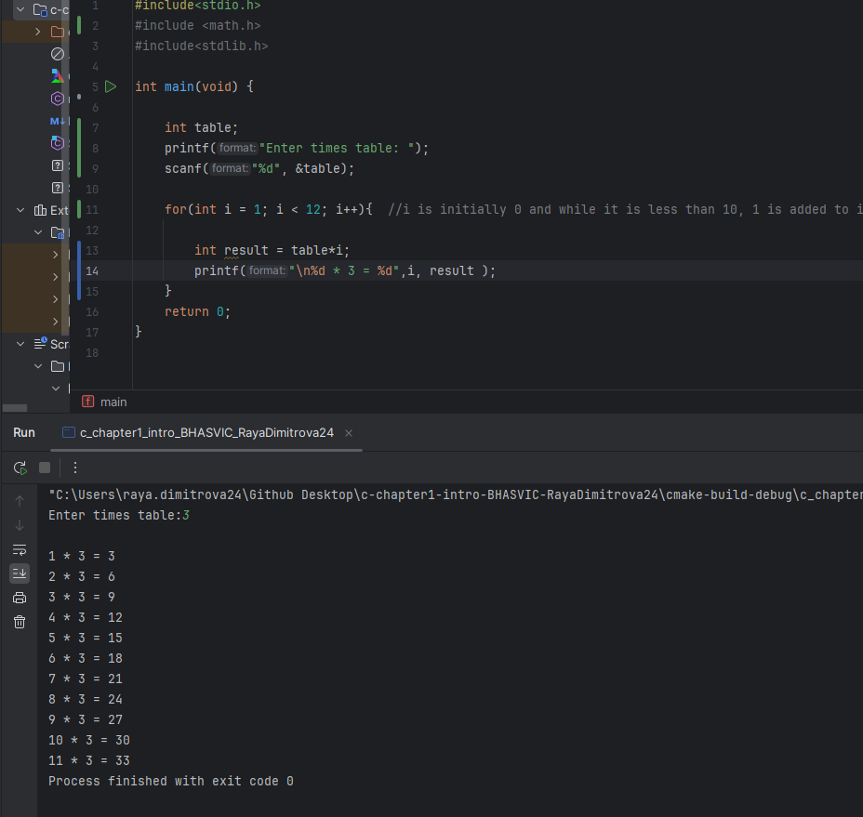
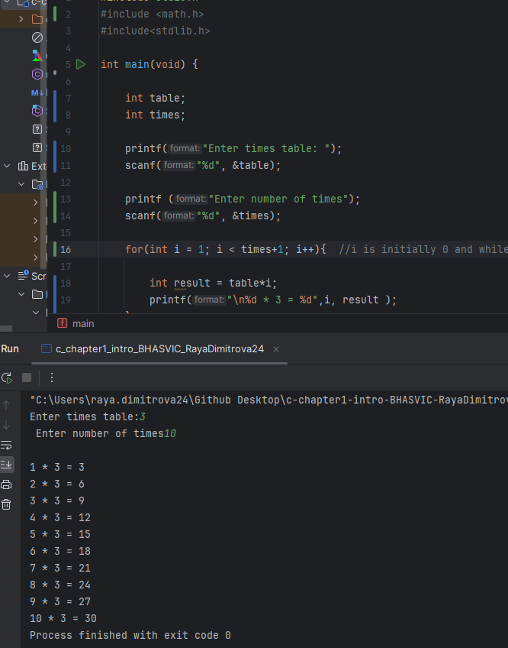
Part 2
Part 3

Slide 10
Make
Make Activities
Write a program to display the cube of the number up to a given integer. Requirements: The user will enter the number to show cubes up to Expected Output e.g.: Number is : 1 and cube of the 1 is :1 Number is : 2 and cube of the 2 is :8 Number is : 3 and cube of the 3 is :27 Number is : 4 and cube of the 4 is :64 Number is : 5 and cube of the 5 is :125

Slide 11
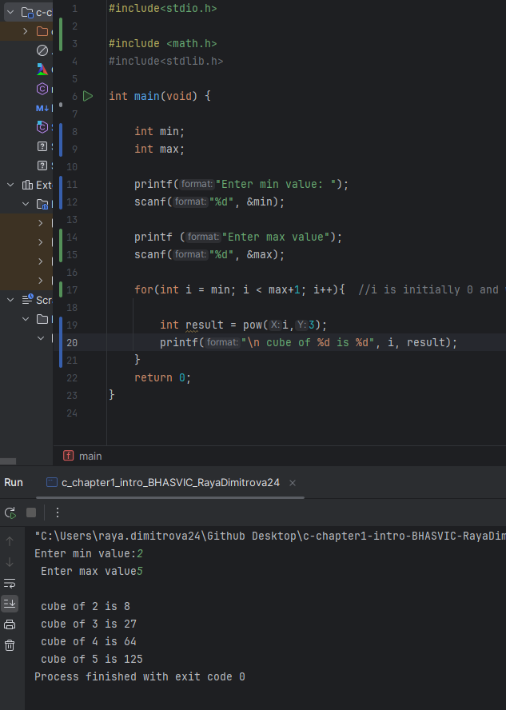

Slide 12
Make
Make Activities
Write a program to display the pattern like the one shown below, where a right angle triangle is created with a series of numbers. Requirements: The user will enter the number of lines of the triangle e.g. 5 Expected Output e.g.: 1 1 2 1 2 3 1 2 3 4 1 2 3 4 5

